Slide 1
EECT 112 Lab Notebook
By CaFischer
Fall 2018
EECT 112
Partners: Ali Algethmi (1,5), David (3), Jeanie Hess (6-9)

Slide 2
Labs index
Lab:
Lab 1-Logic Level
Lab 2-Number Conversions
Lab 3-Logic Gates
Lab 4-Lecture 3b Slide 3
Lab 5-Two Input Gates
Lab 6-Boolean Theorems
Lab 7-Circuit Reduction (part 1)
Lab 8-Circuit Reduction (part 2)
Lab 9-1 to 3 Clock
Page:
3
8
12
16
20
24
38
42
46

Slide 3
Lab 1-Logic Levels
Goal:
The goal of this lab was to learn how to create logic levels for digital circuits using switches and resistors.
The tools used were a Digital Multimeter, an Elvis II, 3 10kW resistors, a dip switch, Multisim, and Excel to record all data
My lab partner was Ali Algethmi and we used bench 6
The date was 9/13/2018

Slide 4
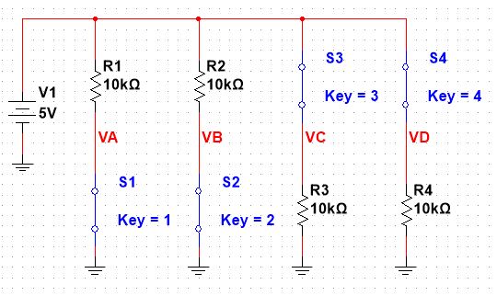
Lab 1-Logic Levels
Procedure:
I made a multisim simulation with four branches where two resistors were before and two resistors were after the switches
I measured at points VA, VB, VC, VD with all possible combinations of open and closed doors for the first to and the last two branches
I measured with probes

Slide 5
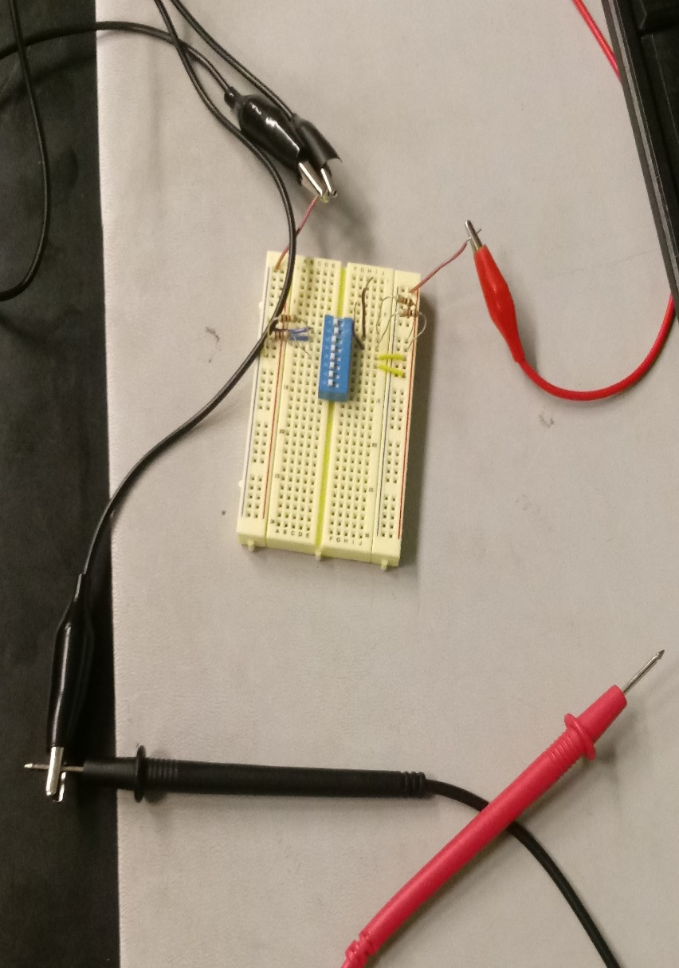
Lab 1-Logic Levels
Procedure:
I hooked everything to the breadboard, first with the resistors before the switch in the circuit and measured for all possible switch positions
Then I did the same with the resistors placed after the switch

Slide 6
Lab 1-Logic Levels
Results:
I found that when a switch was closed before a resistor the multimeter set between them read that the Voltage was equal to a logic 5V
It was reversed when the switches and the resistors were in reverse positions
Simulated |  |  |  |  | Test
S1 | S2 | VA | VB |  | S1 | S2 | VA | VB
open | open | 5 | 5 |  | open | open | 4.96V | 4.96V
open | closed | 5 | 50.0E-9 |  | open | closed | 4.95V | 0.00V
closed | open | 50.0E-9 | 5 |  | closed | open | 0.00V | 4.95V
closed | closed | 50.0E-9 | 50.0E-9 |  | closed | closed | 0.00V | 0.00V
Simulated |  |  |  |  | Test
S3 | S4 | VC | VD |  | S3 | S4 | VC | VD
open | open | 500.0E-6 | 500.0E-6 |  | open | open | 0.00V | 0.00V
open | closed | 500.0E-6 | 5 |  | open | closed | 0.00V | 4.95V
closed | open | 5 | 500.0E-6 |  | closed | open | 4.95V | 0.00V
closed | closed | 5 | 5 |  | closed | closed | 4.95V | 4.95V

Slide 7
Lab 1-Logic Levels
Observations:
Though the multisim simulation read a specific number where there were logic zeros, this value is completely inconsequential thus it is called a logic zero.

Slide 8
Lab 2-Number Conversions
Goal:
The purpose of the lab was to learn how to convert numbers from one base to another
I used the world wide web and Excel
I had no lab partner
The date was 9/6/2018

Slide 9
Lab 2-Number Conversions
Procedure:
The first conversion I did was from 5 bit binary and 8 bit binary to decimal
This is done by multiplying each 1 and 0 by 2 whose exponent changes depending on position
The results of the multiplications are then added
The result is the value of the binary numbers into decimal
This can be done for any and all bit binary numbers
2⁴ | 2³ | 2² | 2¹ | 2⁰
1 | 1 | 0 | 1 | 1
16 | 8 | 4 | 2 | 1
16 | 8 | 0 | 2 | 1 | = | 27
11011 |  |  |  |  | = | 27
5 Bit Binary Min | 0 | Decimal value = | 0
5 Bit Binary Max | 11111 | Decimal value = | 31
8 Bit Binary Min | 0 | Decimal value = | 0
8 Bit Binary Max | 11111111 | Decimal value = | 255

Slide 10
Lab 2-Number Conversions
Procedure:
The next conversion I did was from hexadecimal to decimal
This is done by multiplying each number by 16 whose exponent changes depending on position
The results of the multiplications are then added to make the hexadecimal value
But this is a bit more complicated than the binary because of the addition of letters in place of number values
Multipliers | 16^2 | 16^1 | 16^0
 | 256 | 16 | 1
Decimal | 1 | 2 | 3
Hexadecimal | 256 | 32 | 3 | 291
Decimal | Hexadecimal
10 | A
11 | B
12 | C
13 | D
14 | E
15 | F
16 | 10
2253 | 8CD
 | 140.813 | 140 |  |  | 13
 | 8.75 | 8 |  | 12
 | 0.5 | 0 | 8
 |  |  | 8 | 12 | 13
 |  |  | 8 | C | D

Slide 11
Lab 2-Number Conversions
Observations:
When broken down, binary and hexadecimal numbers become simple addition. Though it’s especially difficult depending on what value is translated to and from the alternative numerical system.
The hexadecimal, for example, uses letters A through F which is difficult for excel to calculate using the standard decimal system.

Slide 12
Lab 3-Logic Gates
Goal:
The purpose of the lab was to learn how to test AND and OR logic gates.
The tools used were a Digital Multimeter, an Elvis II, 2 10kW resistors, a dip switch, a 74LS08N logic gate, a 74LS32 logic gate, Multisim, and Excel to record all data
My partners were David Dixon and Nicholas Rupert and we used bench 6
The date was 9/13/2018

Slide 13
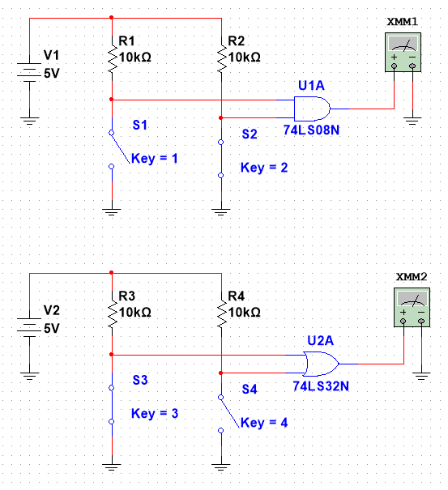
Lab 3-Logic Gates
Procedure:
Using Multisim, I read all possible outputs for all possible inputs for both an OR gate and an AND gate circuit
By making this circuit I was able to get a good grasp on how the switches work when placed after the logic gates

Slide 14
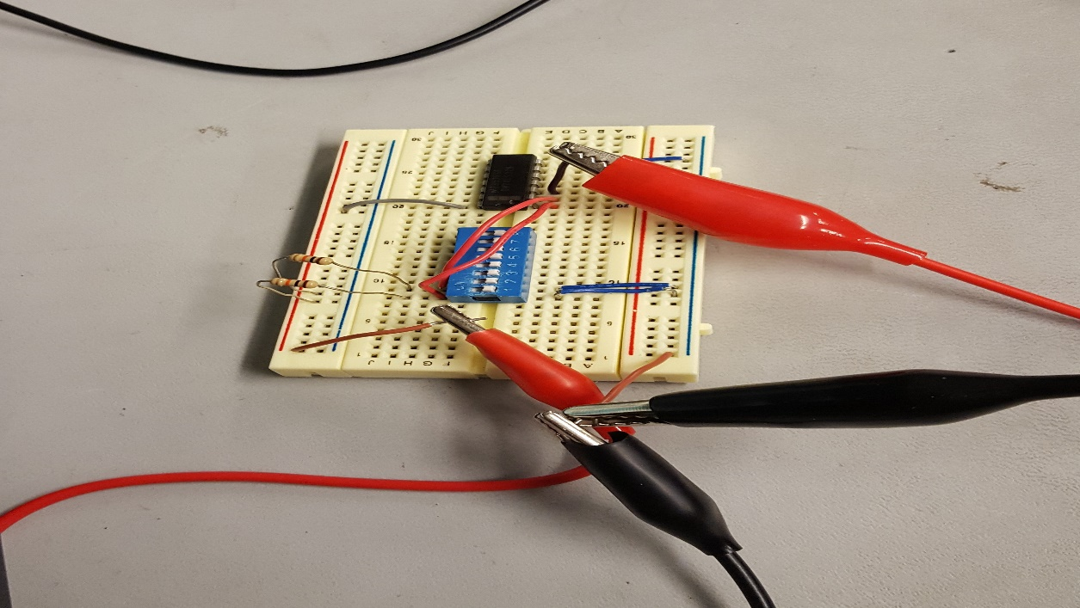
Lab 3-Logic Gates
Procedure:
I assembled the circuit as pictured on the right with a ground attached to each side of the multimeter and then to the circuit at the output of our gate and at the by our Elvis II output.

Slide 15
Lab 3-Logic Gates
AND Gate:
Observations:
When the switch is closed, the circuit is shorted giving the reading of a logic zero
It’s a bit counter-intuitive to me how the switches work when attached this way, but it worked well
Simulated |  |  |  |  | Test
S1 | S2 | VA | VB |  | S1 | S2 | VA | VB
open | open | 5.00V | 5.00V |  | open | open | 4.96V | 4.96V
open | closed | 5.00V | 50nV |  | open | closed | 4.95V | 0.00V
closed | open | 50nV | 5.00V |  | closed | open | 0.00V | 4.95V
closed | closed | 50nV | 50nV |  | closed | closed | 0.00V | 0.00V
OR Gate:
Simulated |  |  |  |  | Test
S3 | S4 | VC | VD |  | S3 | S4 | VC | VD
open | open | 500uV | 500uV |  | open | open | 0.00V | 0.00V
open | closed | 500uV | 5.00V |  | open | closed | 0.00V | 4.95V
closed | open | 5.00V | 500uV |  | closed | open | 4.95V | 0.00V
closed | closed | 5.00V | 5.00V |  | closed | closed | 4.95V | 4.95V

Slide 16
Lab 4-Lecture 3b Slide 3
Goal:
The Purpose of this lab was to learn more about Logic circuits and how to describe them algebraically.
The tools used were a Digital Multimeter, an Elvis II, 3 10kW and 3 1kW resistors, a dip switch, a 74LS08 logic gate, a 74LS32 logic gate, Multisim, and Excel to record all data
My partner was Ali Algethmi and we used bench 3
The date was 9/27/2018

Slide 17
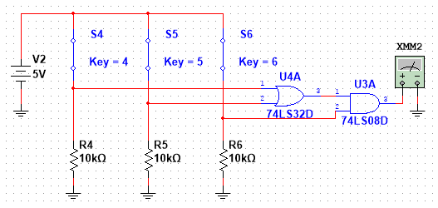
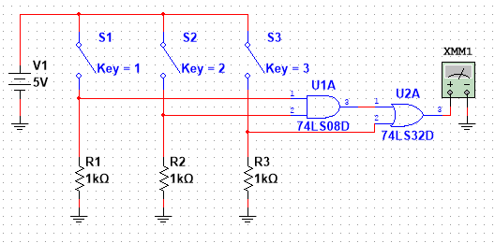
Lab 4-Lecture 3b Slide 3
Procedure:
We made two circuits that were identical except for the Logic gates whose positions were switched
Effectively, the top circuit pictured here has the Boolean algebra expression (A+B)*C
And the Boolean expression for the lower circuit is (A*B)+C

Slide 18
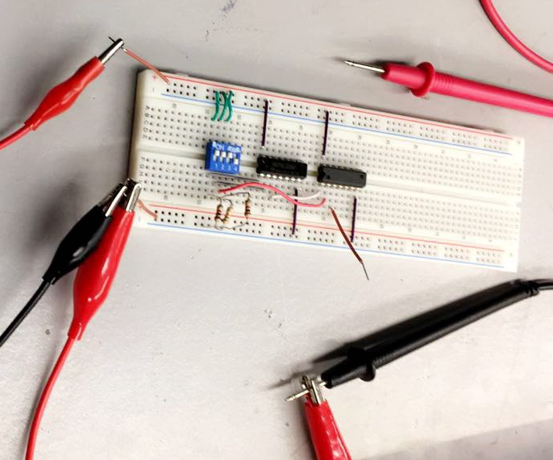
Lab 4-Lecture 3b Slide 3
Procedure:
Here pictured is a circuit with the AND and OR gates attached to three inputs bordered by switches and resistors leading to ground
When we were done reading all outputs for the (A+B)*C circuit we were able to simply switch both logic gates and then read all outputs for the (A*B)+C circuit

Slide 19
Lab 4-Lecture 3b Slide 3
(A+B)*C |  |  | Simulated | Test
 |  |  | Output | Output
S1 | S2 | S3
Open | Open | Open | 0V | 0.17V
Open | Open | Closed | 0V | 0.17V
Open | Closed | Open | 0V | 0.17V
Open | Closed | Closed | 5V | 4.38V
Closed | Open | Open | 0V | 0.17V
Closed | Open | Closed | 5V | 4.38V
Closed | Closed | Open | 0V | 0.17V
Closed | Closed | Closed | 5V | 4.38V
Observations:
In the measured experiment the resistors prescribed were too high to get accurate readings. When assembled with 10k ohm resistors the OR gates gave an input higher than a logic 0 (<0.8V)
We found the correct results when we swapped the 10k resistors for 1k
A*B+C |  |  | Simulated | Test
 |  |  | Output | Output
S1 | S2 | S3
Open | Open | Open | 0V | 0.16V
Open | Open | Closed | 5V | 4.37V
Open | Closed | Open | 0V | 0.16V
Open | Closed | Closed | 5V | 4.37V
Closed | Open | Open | 0V | 0.16V
Closed | Open | Closed | 5V | 4.37V
Closed | Closed | Open | 5V | 4.37V
Closed | Closed | Closed | 5V | 4.37V

Slide 20
Lab 5-Two Input Gates
Goal:
The Purpose of this lab was to learn how two input logic gates work using digital ICs, switches and resistors.
The tools used were a Digital Multimeter, an Elvis II, 3 10kW and 3 1kW resistors, a dip switch, one of each 74LS08, 74LS32, 274LS86, and 74LS04 logic gates, Multisim, and Excel to record all data
My partner was Ali Algethmi and we used bench 3
The date was 10/4/2018

Slide 21
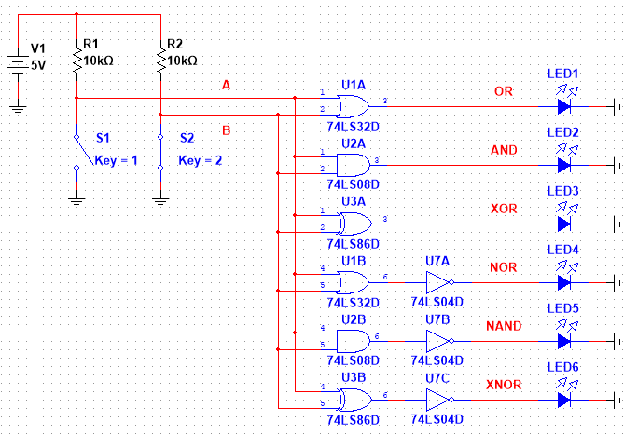
Lab 5-Two Input Gates
Procedure:
Pictured here is the simulation of 6 different types of logic gates
The bottom 3 have outputs inverse to the top 3 with the same inputs

Slide 22
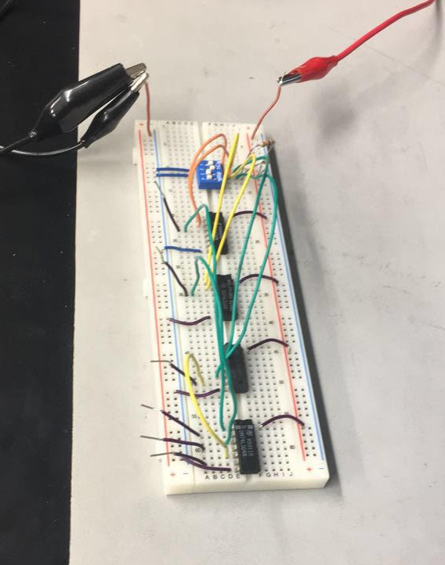
Lab 5-Two Input Gates
Procedure:
Placed on the breadboard were one of each OR, AND, and XOR logic gates and a hex inverter. This way we could test all 6 outputs at the same time
Ground was attached to the negative multimeter probe and the positive was used to measure the outputs

Slide 23
Lab 5-Two Input Gates
Observations:
Although we recorded the logic values here I observed that our voltage levels ran low on all outputs
The inversion was as expected as shown on the table to the right
Simulated |  |  |  |  |  | Test
A = | 0 | 0 | 1 | 1 |  | A = | 0 | 0 | 1 | 1
B = | 0 | 1 | 0 | 1 |  | B = | 0 | 1 | 0 | 1
OR | 0 | 1 | 1 | 1 |  | OR | 0 | 1 | 1 | 1
AND | 0 | 0 | 0 | 1 |  | AND | 0 | 0 | 0 | 1
XOR | 0 | 1 | 1 | 0 |  | XOR | 0 | 1 | 1 | 0
NOR | 1 | 0 | 0 | 0 |  | NOR | 1 | 0 | 0 | 0
NAND | 1 | 1 | 1 | 0 |  | NAND | 1 | 1 | 1 | 0
XNOR | 1 | 0 | 0 | 1 |  | XNOR | 1 | 0 | 0 | 1

Slide 24
Lab 6-Boolean Theorems
Goal:
The Purpose of this lab was to prove 15 of the 19 main theorems related to Boolean Algebra, excluding the 9 and 12 because they’re rather obvious
The tools used were a Digital Multimeter, an Elvis II, 4 1kW resistors, a dip switch, 1 74LS08, 2 74LS32, and 1 74LS04 logic gates, Multisim, and Excel to record all data
My partner was Jeanie Hess and we used bench 6
The date was 11/1/2018

Slide 25
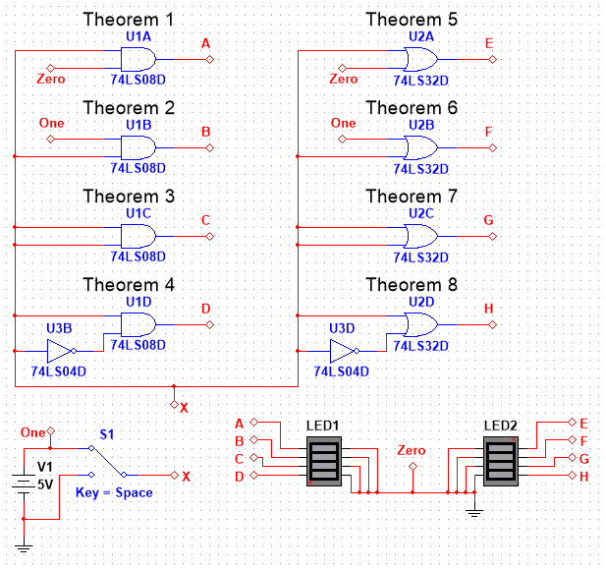
Lab 6-Boolean Theorems
Procedure:
I began by simulating theorems 1-8 in Multisim
(1) x*0=0
(2) x*1=x
(3) x*x=x
(4) x*xbar=x
(5) x+0=x
(6) x+1=1
(7) x+x=x
(8) x+xbar=1

Slide 26
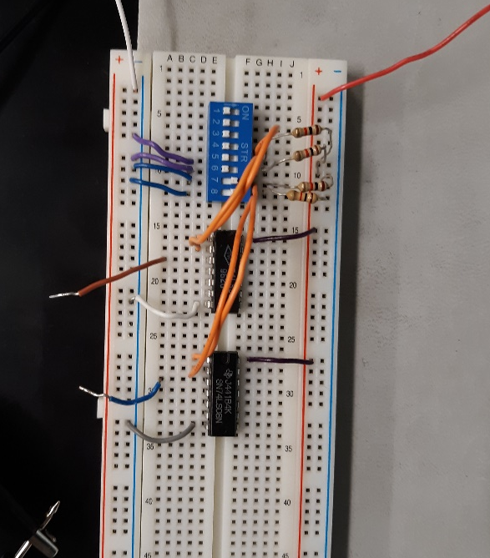
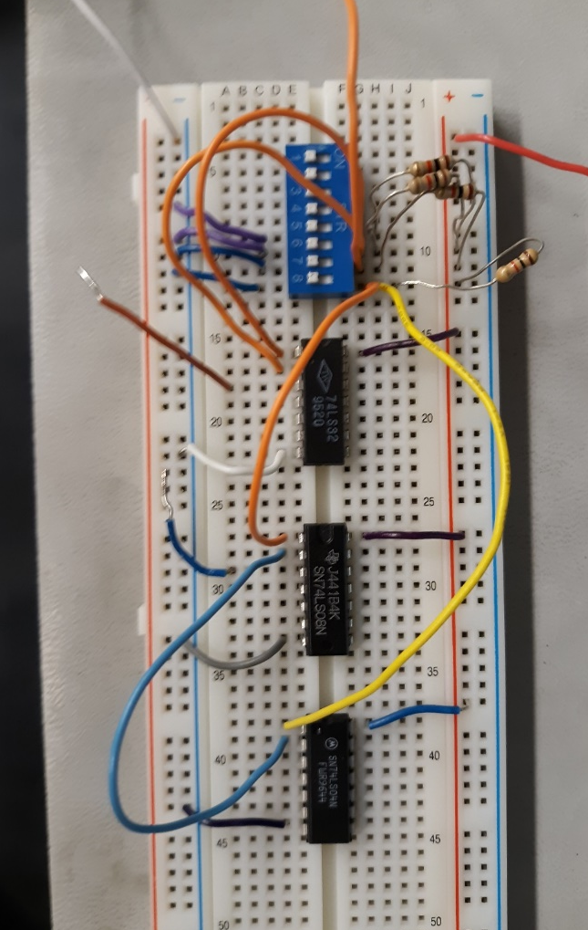
Lab 6-Boolean Theorems
Procedure:
Labs 1-3 and 5-8 each needed a on small adjustment using the left picture configuration and were rather easy to measure as there were only 2 inputs to record
Lab 4 and 8 were done using the set up on the right. We have one input going through the hex inverter then into the AND gate for theorem 4. Then we made the simple switch to an OR gate for theorem 8

Slide 27
Lab 6-Boolean Theorems
Results:
The theorems we had to prove were as follows:
Our results in the lab corresponded expectedly to what the Boolean expressions stated depending on the x or not
Theorems 1-8
x | 1 | 2 | 3 | 4 | 5 | 6 | 7 | 8
0 | 0.1174 | 0.1175 | 0.1177 | 0.1183 | 0.7613 | 4.88 | 0.7609 | 4.876
1 | 0.117 | 4.33 | 4.328 | 0.1182 | 4.88 | 4.88 | 4.883 | 4.876

Slide 28
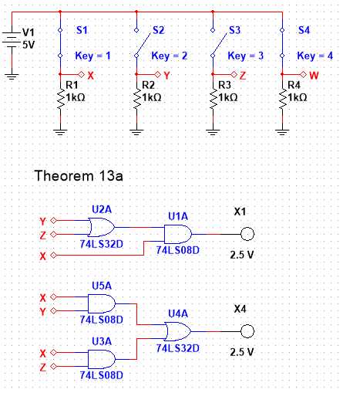
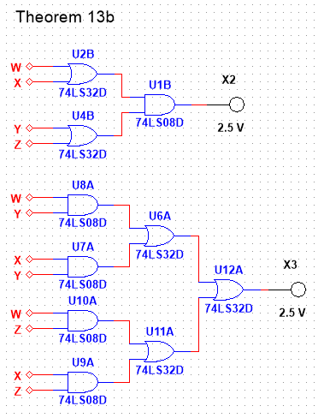
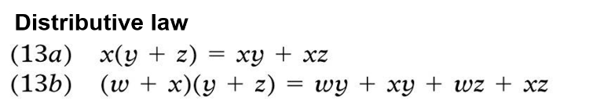
Lab 6-Boolean Theorems
Procedure:
I made theorems 13a and 13b on the same simulation file
For these theorems, in contrast to the first 8, the equality is more difficult to prove than a single output necessitating the use of 2 circuits for each theorem, as will be the case with all the remaining theorems
For each theorem the left of the corresponding Boolean equation is on the top of the simulation

Slide 29

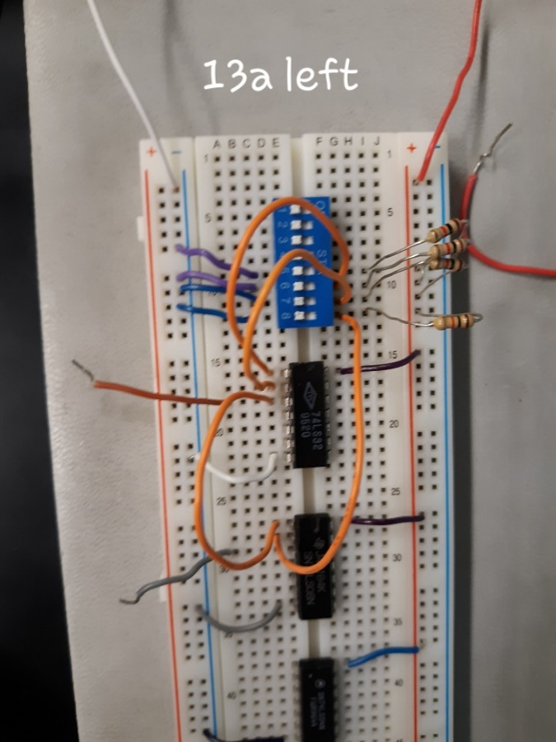
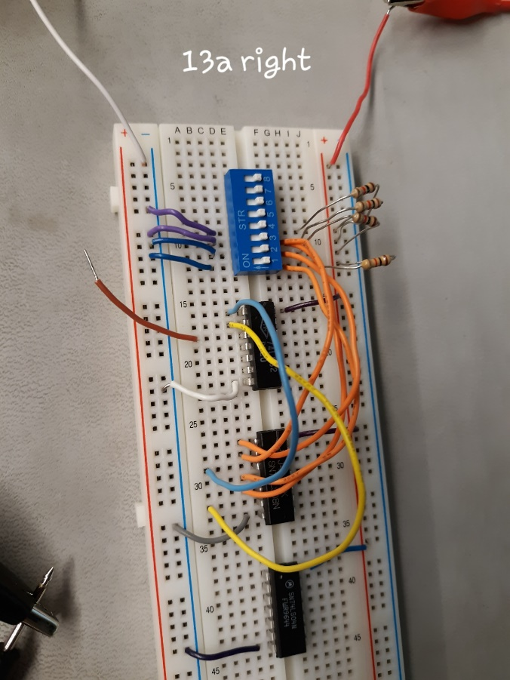
Lab 6-Boolean Theorems
Procedure:
For 13a, we made the left side of the Boolean equation and recorded all data
Then we made the right side of the equation and recorded the data making sure it match the logic of the left side

Slide 30
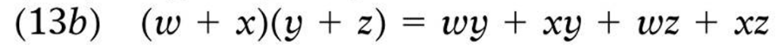
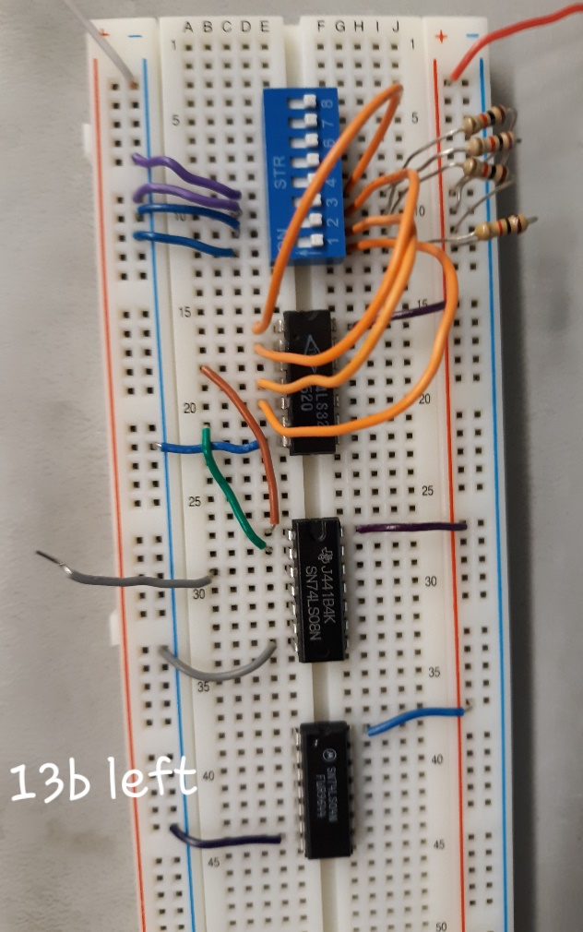
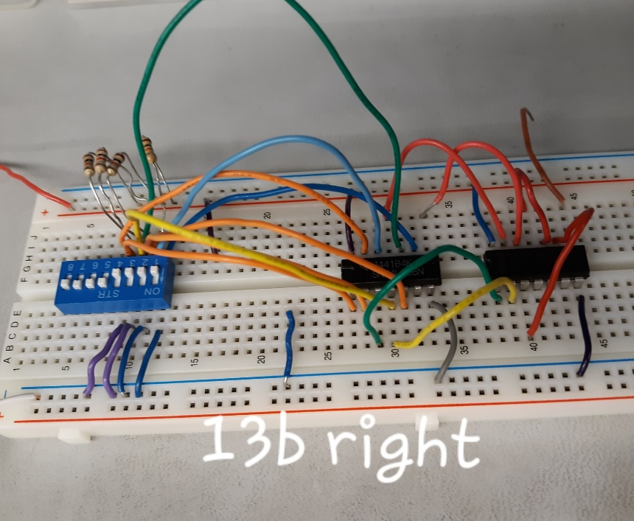
Lab 6-Boolean Theorems
Procedure:
As with 13a we made the left side of theorem 13b and recorded all possible outputs
We then built the right side of 13b and recorded all possible outputs ensuring they matched with our results for the left side

Slide 31
Lab 6-Boolean Theorems
Results:
Though it was rather interesting to see where the voltages vary in the outputs they were as expected
Theorem 13a
x | y | z | 13a left | 13a right
0 | 0 | 0 | 0.1189 | 0.948
0 | 0 | 1 | 0.1189 | 0.948
0 | 1 | 0 | 0.1189 | 0.947
0 | 1 | 1 | 0.1187 | 0.947
1 | 0 | 0 | 0.1189 | 0.947
1 | 0 | 1 | 4.29 | 4.86
1 | 1 | 0 | 4.3 | 4.86
1 | 1 | 1 | 4.3 | 4.867
Theorem 13b
w | x | y | z | 13b left | 13b right
0 | 0 | 0 | 0 | 0.1191 | 0.1357
0 | 0 | 0 | 1 | 0.1191 | 0.1355
0 | 0 | 1 | 0 | 0.119 | 0.1355
0 | 0 | 1 | 1 | 0.119 | 0.1353
0 | 1 | 0 | 0 | 0.119 | 0.1357
0 | 1 | 0 | 1 | 4.292 | 4.005
0 | 1 | 1 | 0 | 4.292 | 4.004
0 | 1 | 1 | 1 | 4.293 | 4.008
1 | 0 | 0 | 0 | 0.119 | 0.1355
1 | 0 | 0 | 1 | 4.293 | 4.002
1 | 0 | 1 | 0 | 4.291 | 4.003
1 | 0 | 1 | 1 | 4.291 | 4.005
1 | 1 | 0 | 0 | 0.119 | 0.135
1 | 1 | 0 | 1 | 4.29 | 4.001
1 | 1 | 1 | 0 | 4.29 | 4.002
1 | 1 | 1 | 1 | 4.292 | 4.005

Slide 32
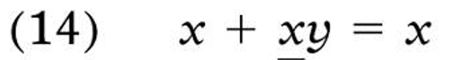
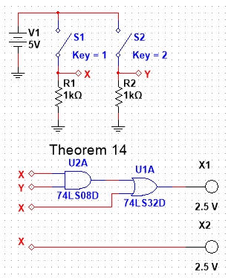
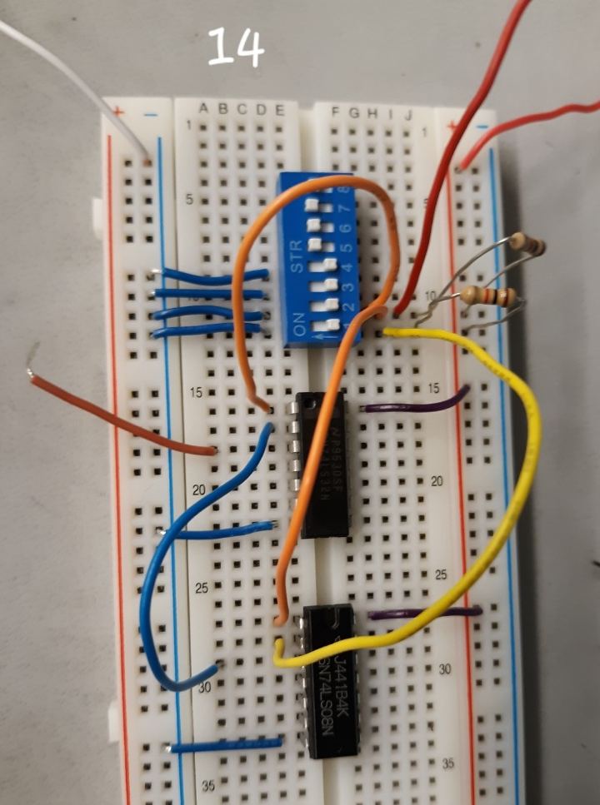
Lab 6-Boolean Theorems
Procedure and Results:
Theorem 14 is extremely simple so I’m not sure why it’s even a theorem
If the input x is a low then the output regardless of y will be a low because the output of the AND gate must have 2 highs to output a high
Theorem 14
x | y | 14 left | 14 right
0 | 0 | 0.1365 | 0.0005
0 | 1 | 0.1363 | 0.0005
1 | 0 | 3.988 | 4.86
1 | 1 | 3.99 | 4.863

Slide 33


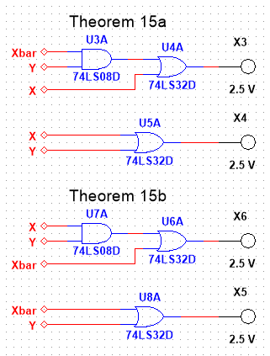
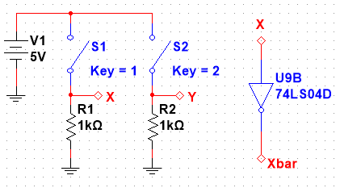
Lab 6-Boolean Theorems
Procedure:
15a and 15b are similar to 14 with the exception of one of the x inputs of the left side that have now been run through a hex inverter making it xbar

Slide 34

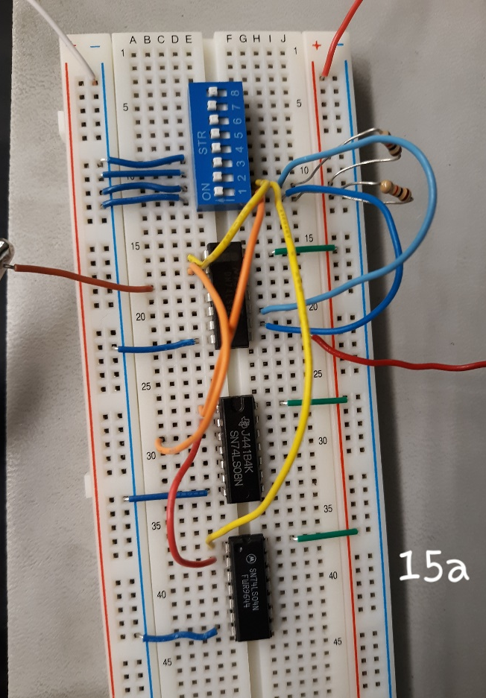
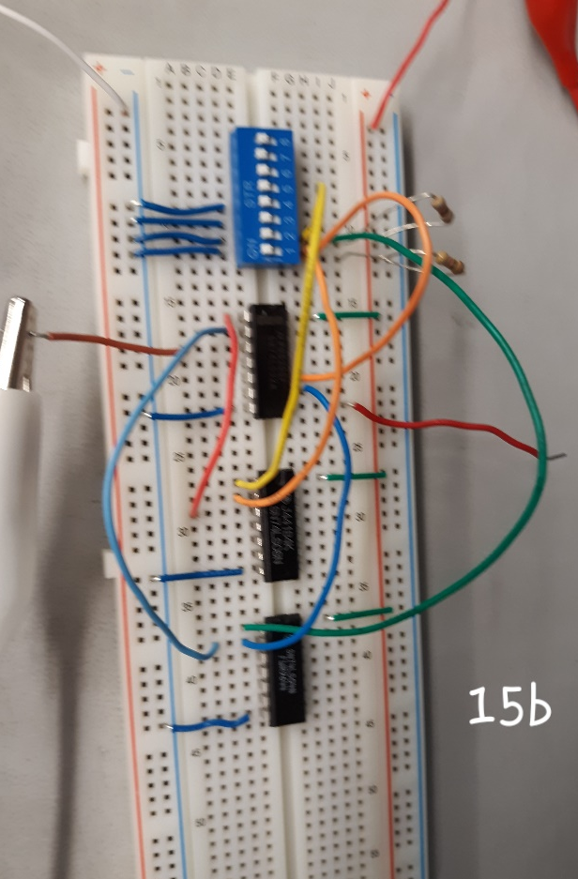
Lab 6-Boolean Theorems
Procedure and Results:
As stated in the last slide, the addition of the hex inverter was the only difference between theorems 15a and 15b and theorem 14
Theorem 15a
x | y | 15a left | 15a right
0 | 0 | 0.1364 | 0.135
0 | 1 | 3.985 | 3.994
1 | 0 | 3.985 | 3.993
1 | 1 | 3.985 | 3.996
Theorem 15b
x | y | 15b left | 15b right
0 | 0 | 3.987 | 3.994
0 | 1 | 3.988 | 3.997
1 | 0 | 0.1367 | 0.1352
1 | 1 | 3.986 | 3.994

Slide 35
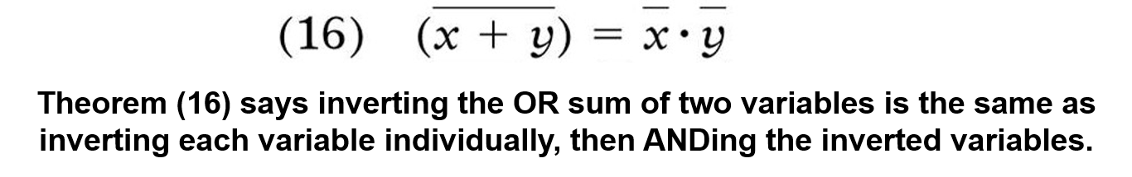
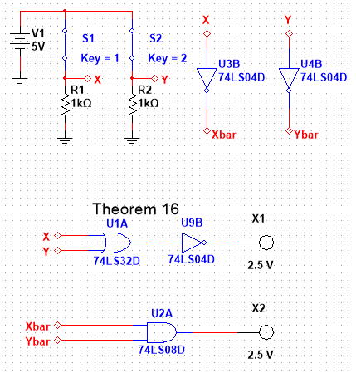
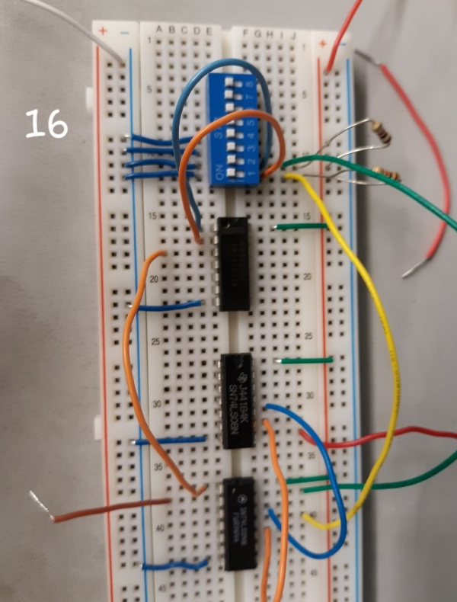
Lab 6-Boolean Theorems
Procedure and Results:
Theorem 16 states that two inputs through an OR gate then a hex inverter is equal to inverting each input then sending them through an AND gate
Theorem 16
x | y | 16 left | 16 right
0 | 0 | 4.267 | 4.278
0 | 1 | 0.1099 | 0.1182
1 | 0 | 0.1099 | 0.1182
1 | 1 | 0.1098 | 0.1181

Slide 36
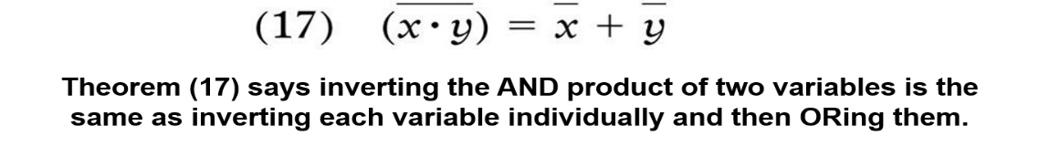
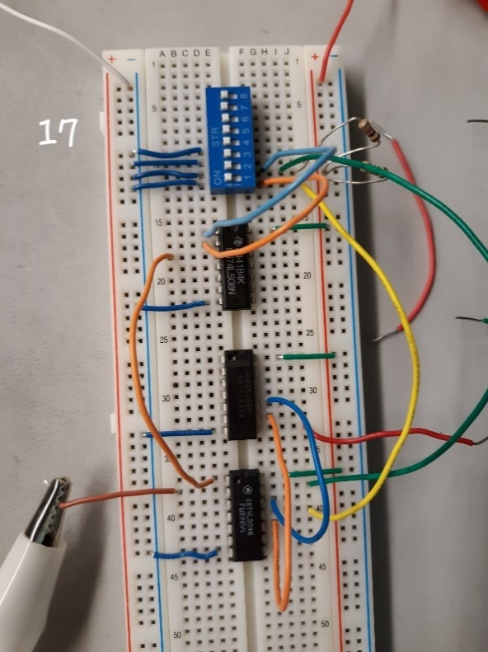
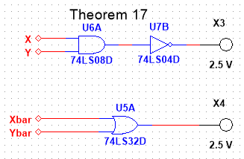
Lab 6-Boolean Theorems
Procedure and Results:
Theorem 17 is exactly like theorem 16, but with the exchange of the AND and OR gates
Theorem 17
x | y | 17 left | 17 right
0 | 0 | 4.268 | 3.995
0 | 1 | 4.268 | 3.993
1 | 0 | 4.261 | 3.993
1 | 1 | 0.11 | 0.135

Slide 37
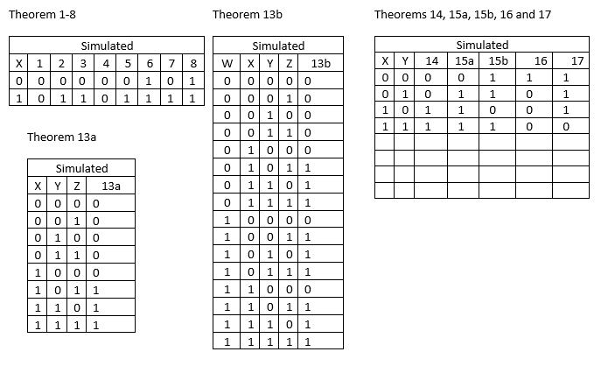
Lab 6-Boolean Theorems
Observations:
I recognize now that I’m to the end of this lab that making the table and displaying it here is more of a formality than anything else as the real purpose for this was to understand these theorems by simply thinking through and building each side

Slide 38
Lab 7-Circuit Reduction (part 1)
Goal:
The Purpose of this lab was to learn how to reduce a circuit to the smallest size possible by using the 17 theorems and Karnaugh maps.
The tools used were a Digital Multimeter, an Elvis II, 3 10kW resistors, a dip switch, 1 74LS00, 1 74LS32, 1 74LS11, and 1 74LS04 logic gates, Multisim, and Excel to record all data
My partner was Jeanie Hess and we used bench 7
The date was 11/8/2018

Slide 39
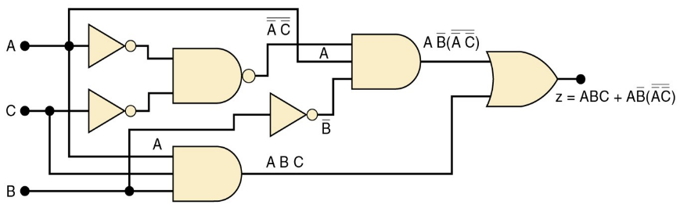
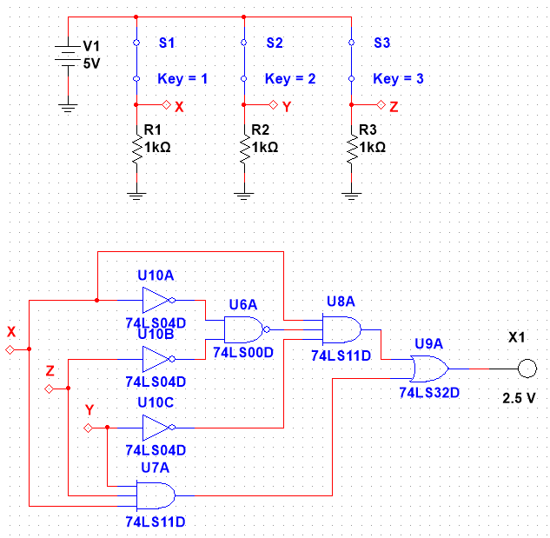
Lab 7-Circuit Reduction (part 1)
Procedure:
To learn how to reduce a circuit we must first build a ridiculous circuit
Pictured at the top is a circuit with Boolean equations at each logic gate and at the final output
Below is my simulation for this lab using xyz in place of abc

Slide 40
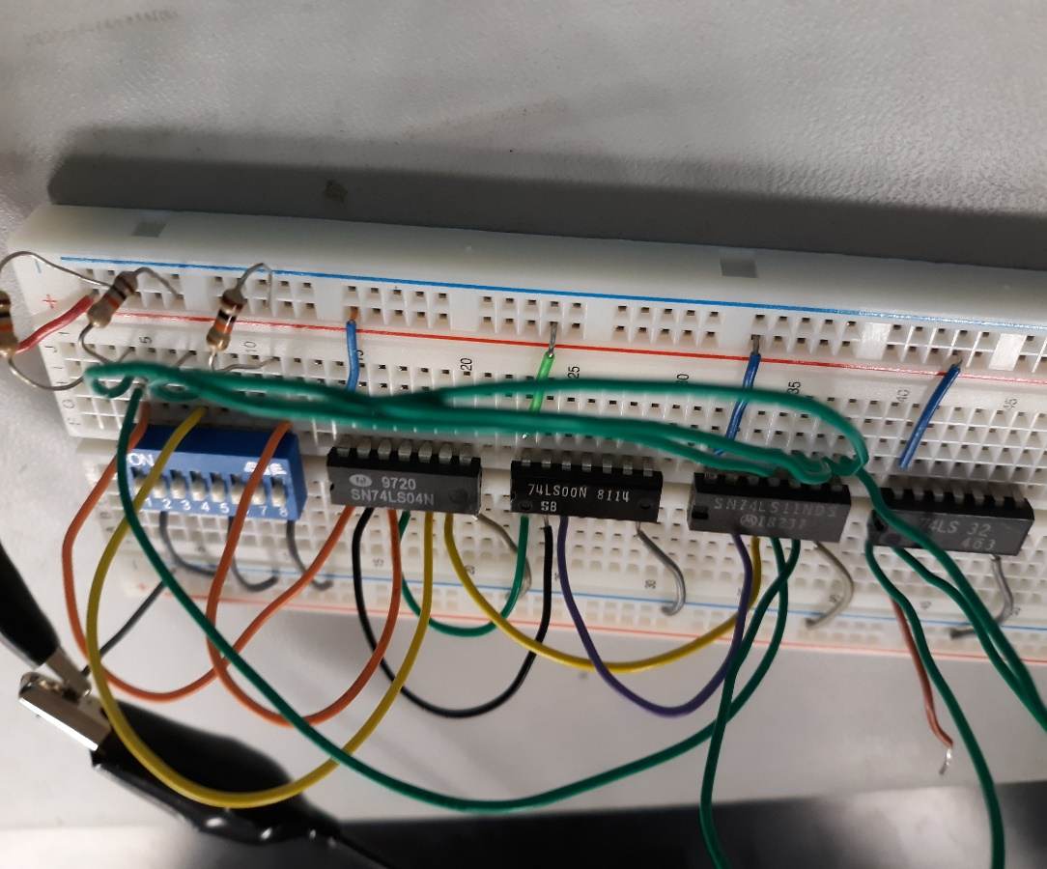
Lab 7-Circuit Reduction (part 1)
Procedure:
This is the convoluted circuit for that simulation
We recorded the outputs for all possible inputs
Simulation |  |  |  |  | Test
A | B | C | Output |  | A | B | C | Output
0 | 0 | 0 | 0 |  | 0 | 0 | 0 | 0.0679
0 | 0 | 1 | 0 |  | 0 | 0 | 1 | 0.068
0 | 1 | 0 | 0 |  | 0 | 1 | 0 | 0.0679
0 | 1 | 1 | 0 |  | 0 | 1 | 1 | 0.0678
1 | 0 | 0 | 1 |  | 1 | 0 | 0 | 4.335
1 | 0 | 1 | 1 |  | 1 | 0 | 1 | 4.3295
1 | 1 | 0 | 0 |  | 1 | 1 | 0 | 0.0688
1 | 1 | 1 | 1 |  | 1 | 1 | 1 | 4.331

Slide 41
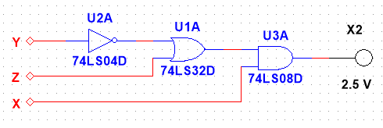
Lab 7-Circuit Reduction (part 1)
Procedure, Results, and Observations:
This lab doesn’t end when we find the outputs. We had to learn how to make a Karnough map using the outputs and using that we were able to reduce the circuit, making the original, an SOP circuit, into a POS circuit (pictured below)
At the top is the Karnough map for this circuit. Using this we were able to reduce the Boolean equation and thus the circuit
SOP stands for Sum-of-Products and POS stands for Product-of-Sums
The way you can tell a POS from an SOP circuit is by whether the last logic gate is an AND or an OR gate
 |  | BC
 |  | 00 | 01 | 10 | 11
A | 0 | 0.129 | 0.129 | 0.129 | 0.129
 | 1 | 4.472 | 4.473 | 0.129 | 4.472
 | X = ABC +ABbar(AbarCbar)bar |  |  |  |  | SOP form
 | X = A(Bbar+C) |  |  |  |  | POS form

Slide 42
Lab 8-Circuit Reduction (part 2)
Goal:
The Purpose of this lab was to learn how to reduce a circuit to the smallest size possible by using the 17 theorems and Karnaugh maps and results from Lab 7.
The tools used were a Digital Multimeter, an Elvis II, 3 10kW resistors, a dip switch, 1 74LS04, 1 74LS08, and 1 74LS32 logic gates, Multisim, and Excel to record all data
My partner was Jeanie Hess and we used bench 7
The date was 11/15/2018

Slide 43
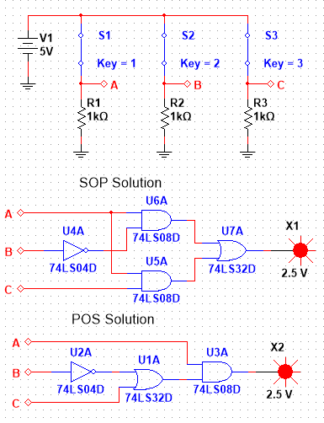
Lab 8-Circuit Reduction (part 2)
Procedure:
Much like in Lab 7, to reduce a circuit we must first build a large one with inconsequential parts
This, while being simpler than the initial circuit in Lab 7, can be reduced further
The reduced POS circuit is the same as for Lab 7 meaning that all 3 large and small circuits have the same outputs

Slide 44
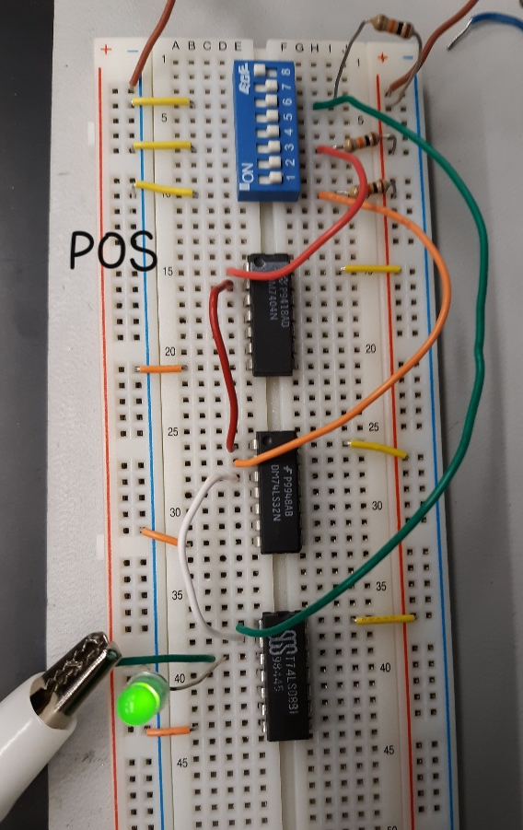
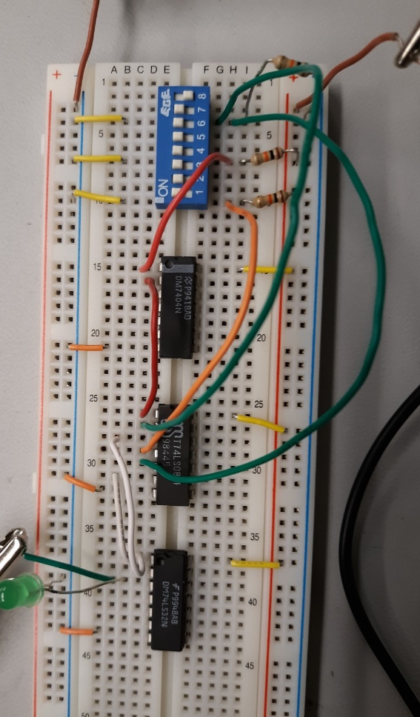
Lab 8-Circuit Reduction (part 2)
Procedure:
On the left is the initial SOP circuit and on the left is the reduced POS
In the lab Jeanie and I tried to use an LED light bulb as in our simulations rather than a Multimeter. This skewed our results and gave us a very low voltage reading (around 2.2V). We could only get higher ones when using only the Multimeter

Slide 45
Lab 8-Circuit Reduction (part 2)
Results and observations:
As seen in the results to the right, these circuits are equivalent in their outputs though on is much more simple when making the circuit
This goes to show that there’s more than one way to skin a cat
Lab 8
Simulation |  |  |  |  |  | Test
 |  |  | Output |  |  |  |  |  | Output
A | B | C | SOP | POS |  | A | B | C | SOP | POS
0 | 0 | 0 | 0 | 0 |  | 0 | 0 | 0 | 0.1176 | 0.1186
0 | 0 | 1 | 0 | 0 |  | 0 | 0 | 1 | 0.1176 | 0.1412
0 | 1 | 0 | 0 | 0 |  | 0 | 1 | 0 | 0.1177 | 0.1417
0 | 1 | 1 | 0 | 0 |  | 0 | 1 | 1 | 0.1176 | 0.1419
1 | 0 | 0 | 1 | 1 |  | 1 | 0 | 0 | 4.221 | 4.354
1 | 0 | 1 | 1 | 1 |  | 1 | 0 | 1 | 4.22 | 4.352
1 | 1 | 0 | 0 | 0 |  | 1 | 1 | 0 | 0.1146 | 0.1425
1 | 1 | 1 | 1 | 1 |  | 1 | 1 | 1 | 4.219 | 4.349

Slide 46
Lab 9-1 to 3 Clock
Goal:
The Purpose of this lab was to
The tools used were a Digital Multimeter, an Elvis II, a 470kW, and a 10kW resistors, .01uF and 1uF capacitors, a dip switch, 2 74LS73 Dual JK flip flops, 1 LM555 timer, Multisim, and Excel to record all data
My partner was Jeanie Hess and we used bench 1
The date was 11/29/2018

Slide 47
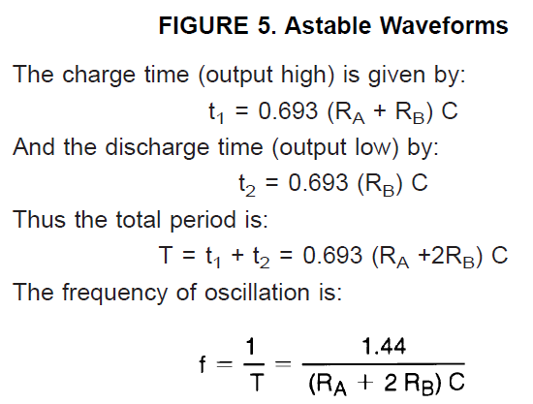
Lab 9-1 to 3 Clock
Procedure:
This one was much more difficult than the previous lab because of the complication of the circuit and new parts
We first calculated the period and frequency this using the equations on page 8 of the LM555 part data sheet
 | Designed | Measured
R_{A} = | 470000 | 475000
R_{B} = | 470000 | 479000
C = | 0.000001 | 0.000001
t₁ = | 0.65142 | 0.661122
t₂ = | 0.32571 | 0.331947
T = | 0.97713 | 0.993069
f = | 1.023405 | 1.0069794
f = | 1.021277 | 1.0048849
D = | 33.333% | 33.426%

Slide 48
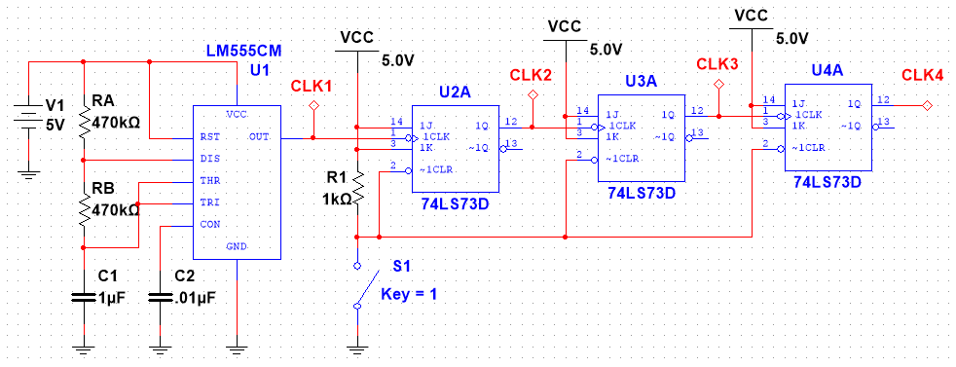
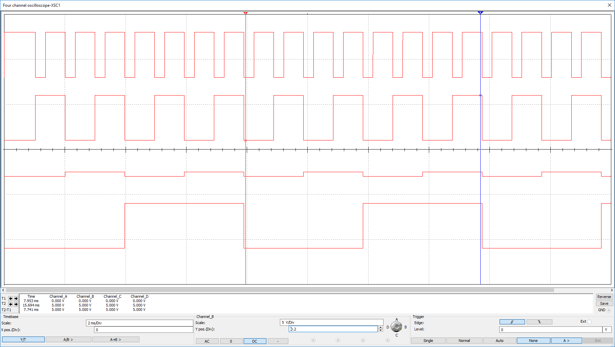
Lab 9-1 to 3 Clock
Procedure:
The LM555 timer with this setup has a period of approximately 0.977 seconds
The waves in the oscilloscope are each a Clock starting with Clock 1 at the top to Clock 4 at the bottom

Slide 49
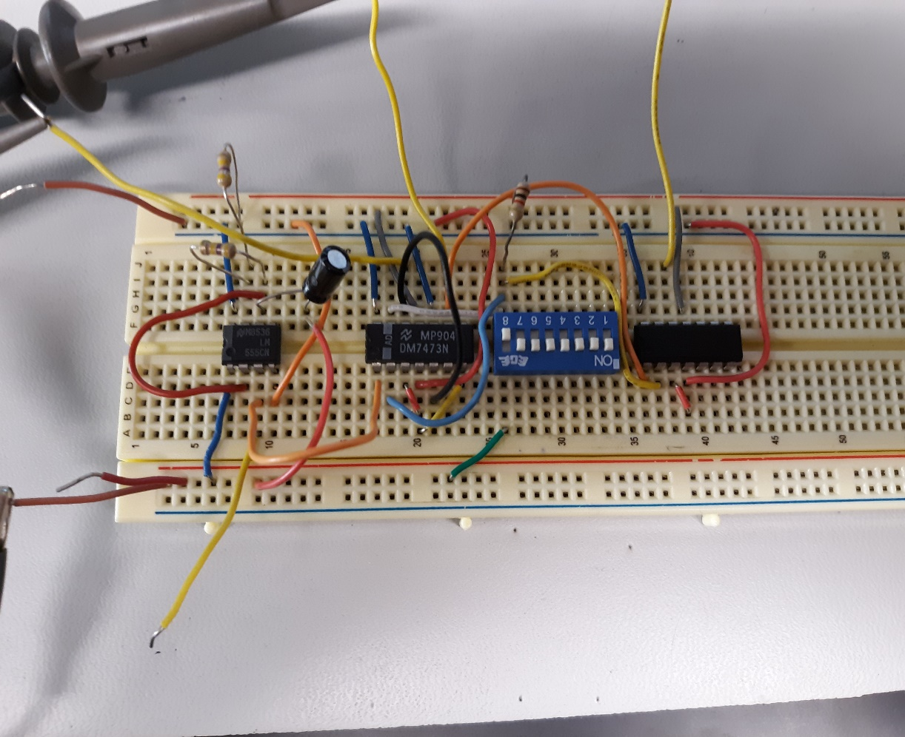
Lab 9-1 to 3 Clock
Procedure:
The first time we built the circuit it didn’t work possibly partially because the method that we used to use for building circuits was messy with this complicated circuit
It was easiest when making the circuit to connect ground and power to each side of the breadboard which was necessitated here by the new parts some of which had multiple ground and power inputs some on opposite sides from each other
This was different than what we were used to having on the logic gates.

Slide 50
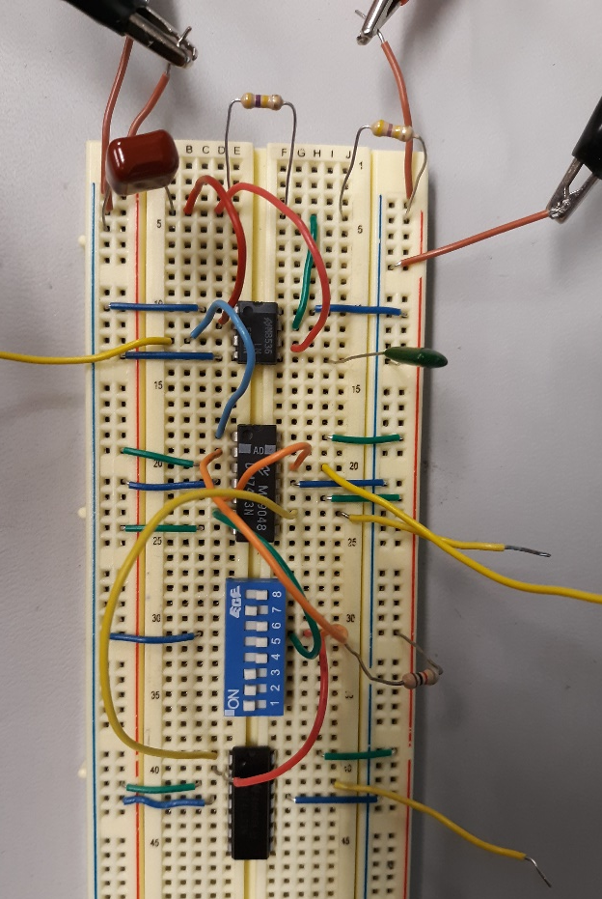
Lab 9-1 to 3 Clock
Procedure:
Our final circuit also had the correct Capacitors (one of which was completely absent from our first)
This time we went part by part and attached ground and power from either side then carefully attached the parts to each other

Slide 51
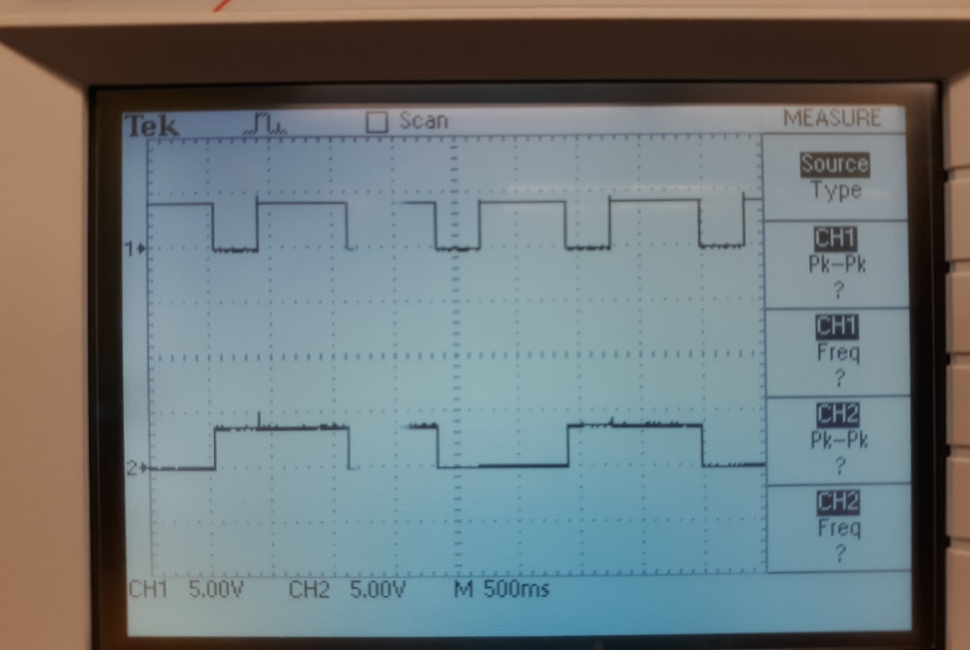
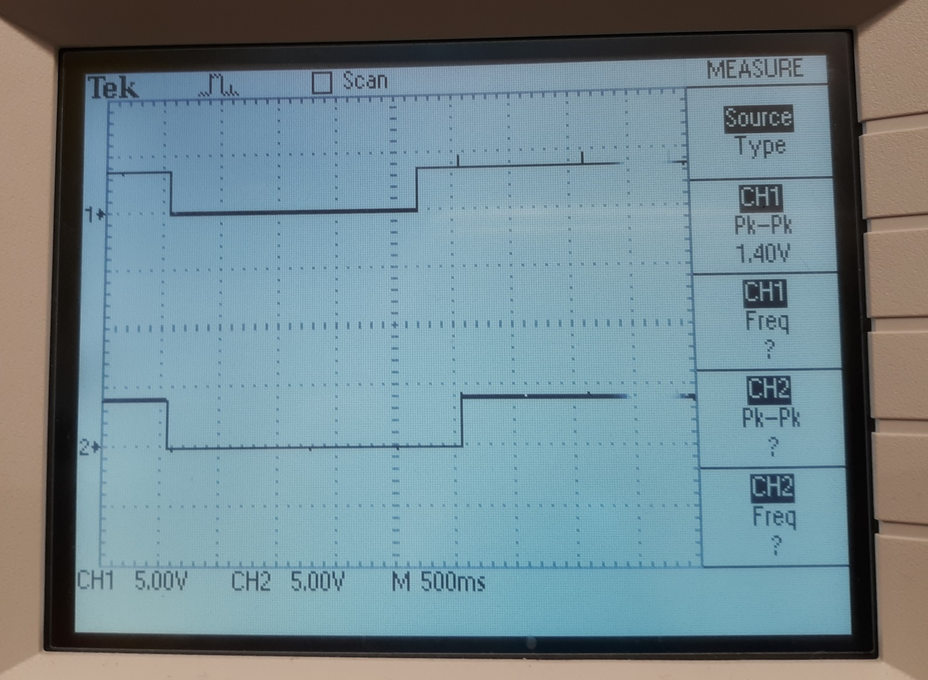
Lab 9-1 to 3 Clock
Procedure and Results:
At the top we have Clock 1. Below that in the same image is Clock 2 which is incredibly near twice the period of Clock 1
The same goes for Clock 2 and Clock 3
Clock 4’s period, however, was supposed to be twice the period of Clock 3 yet was scarcely larger at all

Slide 52
Lab 9-1 to 3 Clock
Observations:
Lab 9 was arduous and we didn’t get the exact results we wanted, but it helped me learn through trial, error, and a good lab partner
If I had the time to do this again I would try to take the time to troubleshoot the circuit more and figure out what was wrong with the final reading whether it was the part or somewhere in how we attached it

